Slide 1
The Power of Spirituality
In
Mental Wellness
Rosangela B. Berbert - MSE,LPC,NCC
Executive Director and Therapist
Samaritan, Inc
(aka Samaritan Counseling Center of the Fox Valley)

Slide 2
Who?

Slide 3
Nonprofit mental health services agency
Founded in 1970 by First Congregational UCC, Appleton
Committed to healing Mind, Body, Spirit and Community
SAMARITAN, Inc.

Slide 4
1970-1974
2022 - …
1974 – 2006
a Samaritan Center
since 1991
2006-2022
Notes:
CREATE ANIMATION TO ENTER EACH LOGO, EACH REPLACING THE PREVIOUS.
REMOVE LINES

Slide 5
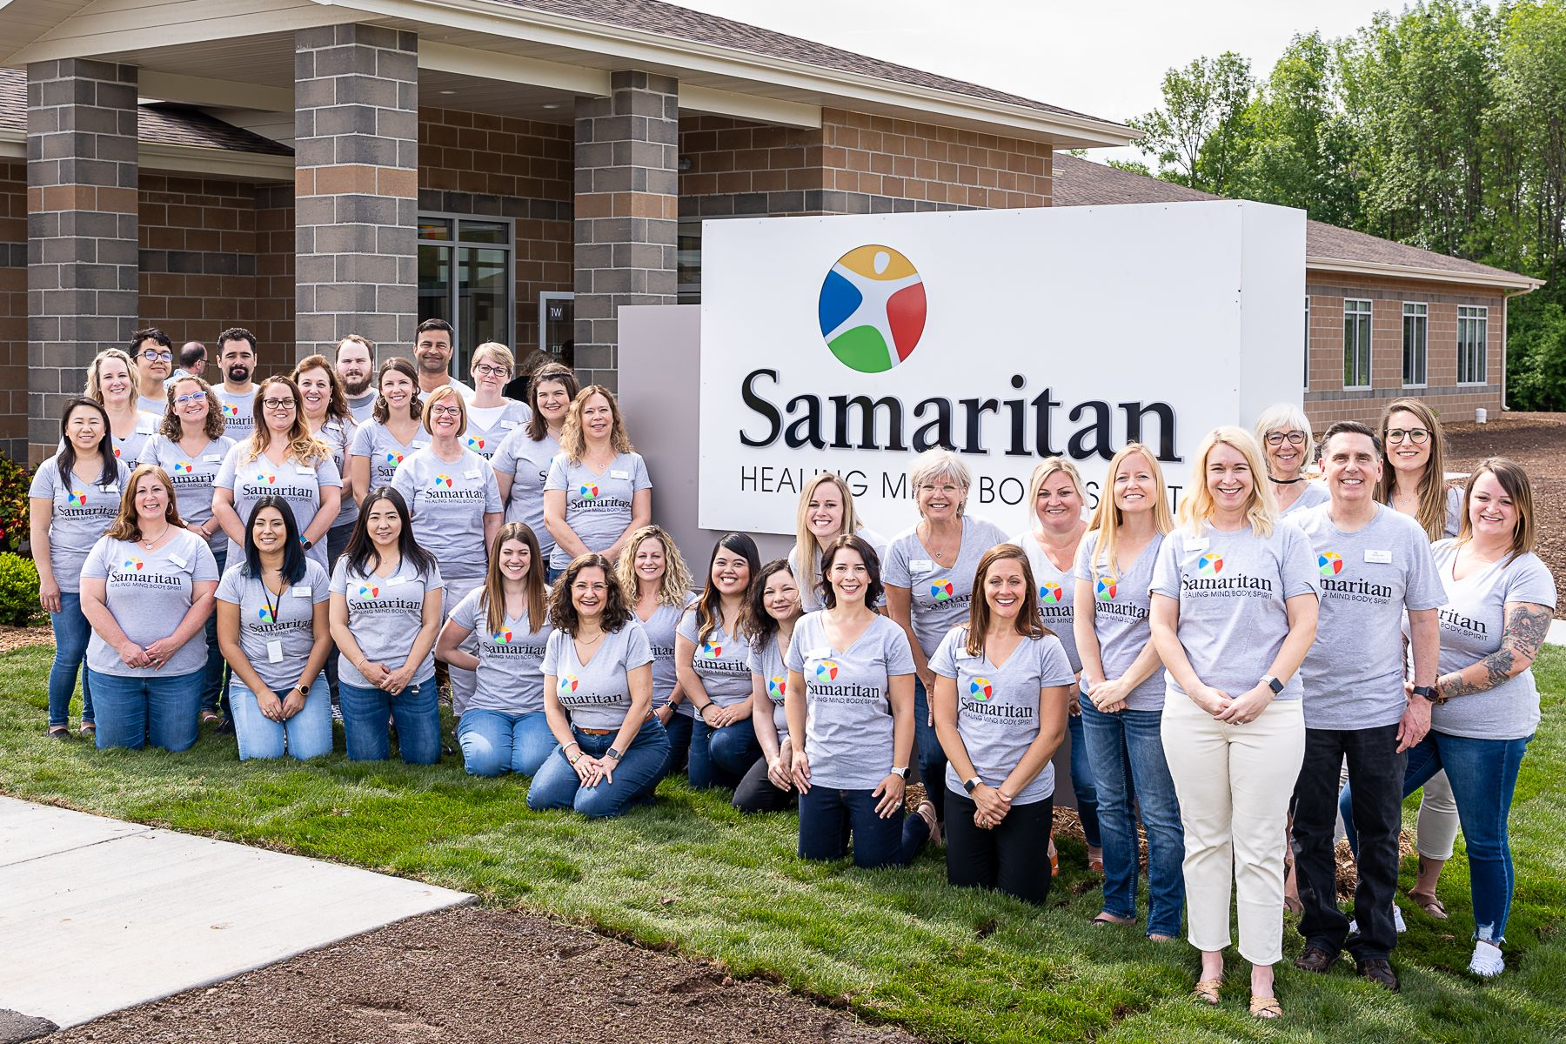
Hello from our staff!
Andy Fastow
Former CFO Enron Founder, Keen Corp
Notes:
14 counselors (6 former trainees; 1 intern, 3 Resid)

Slide 6
LETTING OUR LIGHT SHINE!
Notes:
It’s one thing to dream big — to have a vision that requires bold action and collaboration. It’s quite another to have that vision realized and integrated into our daily work. Today, our facilities now reflect what we, together, were able to manifest. Our new location provides hope. Comfort. Increased capacity. What we sought together is now here. We celebrate with gratitude for all who dreamed and contributed to make this happen.

Slide 7
Why?

Slide 8
2023 The State of Mental Health
in
America
MHA (Mental Health America)
Up from 19.86%
Number of adults experiencing a mental illness: 1 in 5
Adults with a mental illness not able to receive treatment due to costs: more than 1 in 4
Youth with private insurance who do not have coverage for mental or emotional problems: 1 in 10
Up from 24.7%
Up from
8.1%,
950 Million

Slide 9
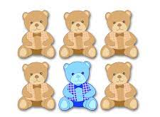
1 in 6 U.S. youth aged 6-17 experience a mental health disorder each year
1 in 5 U.S. adults experience mental illness each year

Slide 10
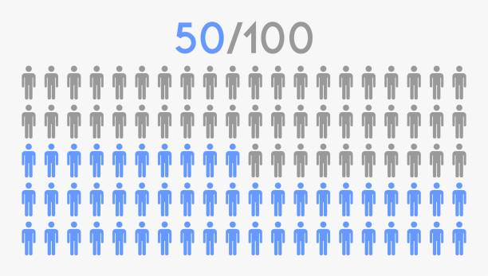
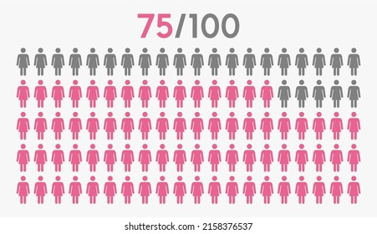
50% of all lifetime mental illness begins by age 14 …
… and 75% by age 24.

Slide 11
What?

Slide 12
Supporting the Community
COMMUNI
TY
C
O
U
N
S
E
L
I
N
G
*
MH & SA
W
E
L
L
N
E
S
S
WELLNESS
S
C
R
E
E
N
Spiritually Integrated Care
Fees for services, Community Investment (Grants, Donations, Sponsorships)

Slide 13
From the first brilliant rays of sunrise to the bright orb of the moon hanging in the night sky, light defines and helps living things grow and flourish. Light inspires us.
We were created and put on this Earth with a unique inner light that is designed to shine bright! And this light is meant to be recognized, celebrated, and affirmed ALWAYS!
We respect, value and affirm the sacred dignity of each person.
Notes:
Just over a year ago, we moved into our new facility at 1205 Province Terrace, Menasha, allowing us to expand our services and help more individuals and families. We could not have made the move without our generous donors — you believed in our plans and understood our community desperately needs quality, cost effective counseling services that wholistically support our clients. We are so grateful to you.

Slide 14
Supporting the Community
C
O
U
N
S
E
L
I
N
G
*
MH & SA
School Based Mental Health Services
W
E
L
L
N
E
S
S
COMMUNI
TY
Faith communities
MHM – 3 tier model
Outpatient Mental health
Substance Abuse
WELLNESS
Leadership Coaching
SBMH Counseling
In English and Spanish
S
C
R
E
E
N
For Faith Communities and other Organizations
Direct service within 40 miles radius
Training Program
Candid™ – licensing model
Spiritually Integrated Care
Fees for services, Community Investment (Grants, Donations, Sponsorships)

Slide 16
IMPACT
2023
1221
Clients in Care by April 31
…
Average # of intakes/mo
in 2022
98.5
In 2023
74
…
Average # of clients/mo
in 2022
761
in 2023
826
342
(~2 FTEs)
By end of 2022
465 (32%)
more clients
compared to 2020
324 (22%)
more clients
compared to 2021
123
(< 1FTE)
Notes:
That represents a 32% increase over the start of the pandemic in 2020

Slide 17
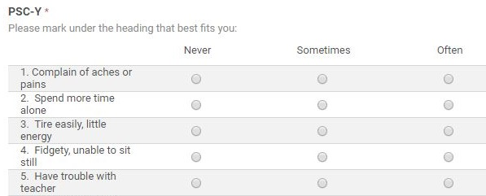
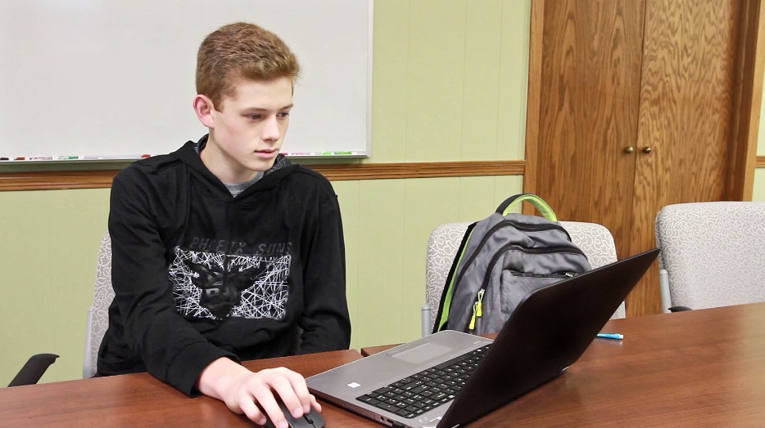
10-min. computer questionnaire
Phone follow-up to refer for care
Case/Referral Management
Summary data for schools
School-Based Mental Health Check-Ups
Photo courtesy Insight Publications

Slide 18
IMPACT
(September 2022 – April 2023)
2020-2021
35% required referral
2021-2022
41% required referral
2022-2023
46% required referral

Slide 19
Clergy & Congregation Care
Open to all faith traditions
Faith leaders are the front line, after health care workers, helping their congregants to deal with the aftermath of Covid and many other life struggles.
They in need of support to continue to recover from the stressors of the past few years and to continue to provide strong systems of support for communities.
Samaritan continues to support clergy and faith communities by offering: 1) Mental Health Training 2) Coaching 3) Support Groups
4) Pulpit Supply
New ideas coming up!

Slide 20
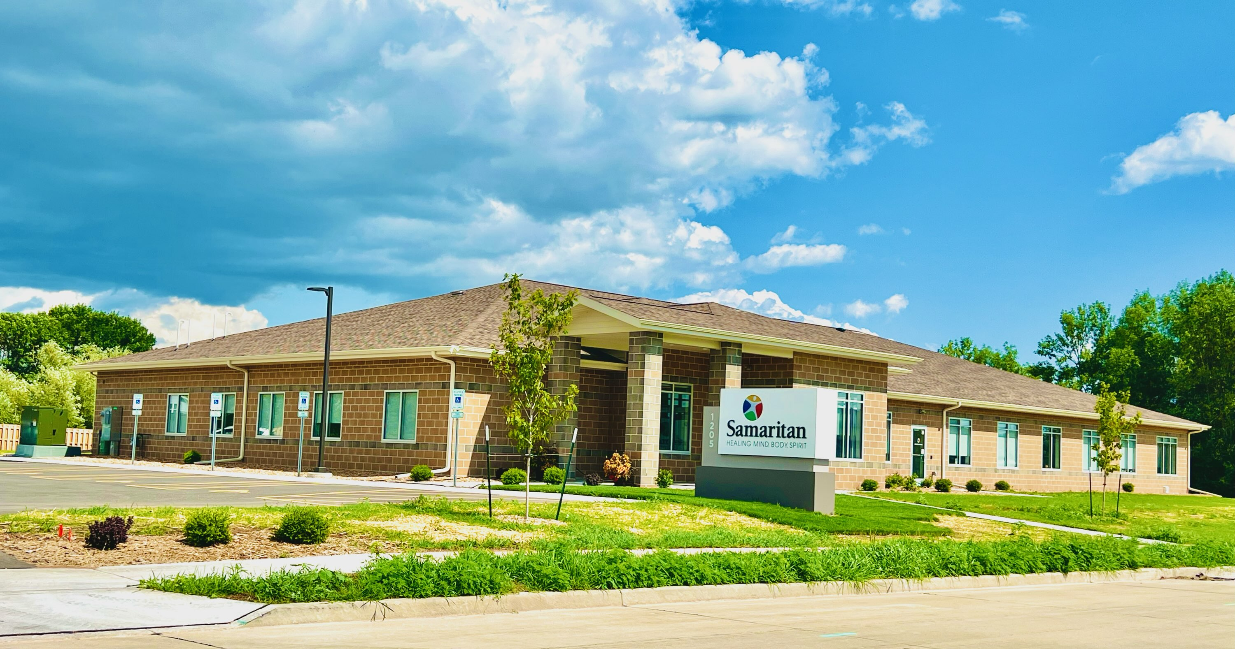
1205 Province Terrace, Menasha
www.samaritanfoxvalley.com

Slide 21
How?

Slide 22
CONNECTING MIND, BODY, AND SPIRIT SO INDIVIDUALS, FAMILIES AND COMMUNITIES THRIVE

Slide 23
Spiritually Integrated Care
( inclusive of all faith traditions and spiritual beliefs)
MIND
HOPE
SPIRIT
BODY

Slide 24
The Power of Spirituality
In
Mental Wellness

Slide 25
Overall objectives:
Consider the differences between spirituality, faith and religion
Explore the concept of Sacred Core and Sacred Journey
Discuss ways a person experiences their spiritual or sacred journey and how it may impact their mental wellbeing
Consider what you have to offer as Faith Community

Slide 26
Faith
Spirituality
Religion
Meaning
Connection/ Belonging
Transcendence
Beliefs and Practices/Rituals
Notes:
FAITH: a firm belief in something for which there is no evidence; faith usually guides attitudes, decisions, and actions.
Faith may be at the beginning of everything. It may be what drives all that is spiritual and scientific (the pursuit of evidence – the belief that there’s something to be found or proved)
Usually in Western culture, Faith is directly connected to an organized religious tradition.
Faith-based: anchored in the tenets of a particular religious tradition and its beliefs, doctrines and practices.

Slide 27
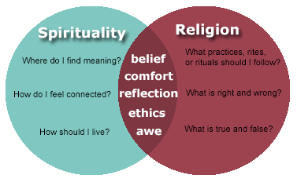
Religion
Transactional
Moral Codes
Collective
Human Construct
Spirituality
Connection to
something bigger
than oneself
Transcendent
Individual
Universal/Innate
Meaning
Connection/ Belonging
Transcendence
Beliefs and Practices/Rituals
What Is Spirituality? | Taking Charge of Your Health & Wellbeing (umn.edu)

Slide 28
… is seeing light with your heart when all your eyes see is darkness.
- Barbara Johnson
HOPE

Slide 29
Overall objectives:
Consider the differences between spirituality, faith and religion
Explore the concept of Sacred Core and Sacred Journey
Discuss ways a person experiences their spiritual or sacred journey and how it may impact their mental wellbeing
Consider what you have to offer as Faith Community

Slide 30
Defining the Sacred
“By sacred things one must not understand simply those personal beings which are called Gods or spirits; a rock, a tree, a spring, a pebble, a piece of wood, a house, in a word, anything can be sacred.”
Sociologist Émile Durkheim,
The Elementary Forms of the Religious Life (1915)

Slide 31
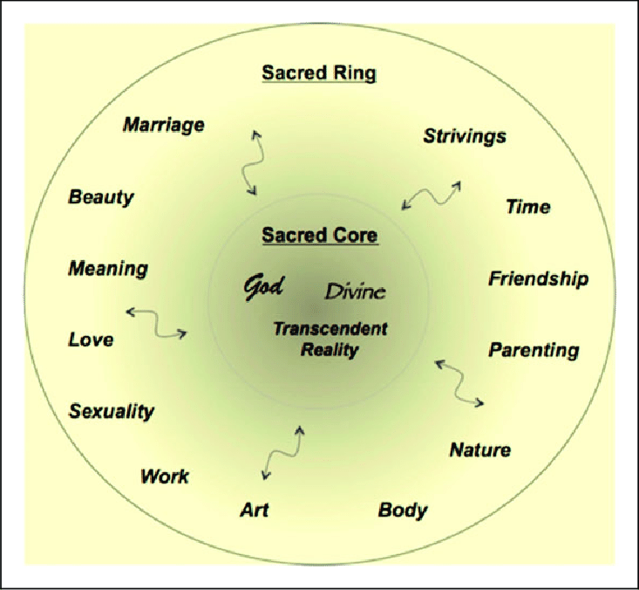
Dr. Kenneth Pargament

Slide 32
Overall objectives:
Consider the differences between spirituality, faith and religion
Explore the concept of Sacred Core and Sacred Journey
Discuss ways a person experiences their spiritual or sacred journey and how it may impact their mental wellbeing
Consider what you have to offer as Faith Community

Slide 33
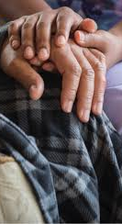

Slide 34
The Ways of the Sacred Core
and Sacred Journey
(Dr. Pargament)
Ways of Knowing (intellectual, mind)
Ways of acting (behaviors, actions, what can be seen by others)
Way of Relating (connections, gives sense of belonging)
Ways of Experiencing: (deeply personal, connection with the transcendent)
Ways of Coping (combines cognitive and relational)

Slide 35
Connecting With Your Sacred Core
From what sources do you draw the strength and courage to go on?
Where do you find peace?
Who truly understands your situation?
When you are afraid or in pain, how do you find comfort and solace?
For what are you deeply grateful?
What sustains you amid your troubles?
Who is your true self?
When in your life have you experienced forgiveness?

Slide 36
The Intersection Between A Person’s Sacred Journey And Mental Wellbeing
“So, unless religion is leading to a deeper spiritual experience, it is likely not enhancing mental health. It is possible to be religious without being spiritual, but it is not possible to be spiritual, truly spiritual, without enhancing one’s mental health”.
Andrea Mathews LPC, NCC Religion vs Spirituality - Which one enhances your mental health? - Psychology Today, Dec 2019

Slide 37
I have an increasing sense that the most important crisis of our time is spiritual and that we need places where people can grow stronger in the spirit and be able to integrate the emotional struggles in their spiritual journeys.
It is into this deeply tired world of ours that God sends Jesus to speak the voice of love. Jesus says, ‘Follow me. Don’t keep running around. Follow me. Don’t just sit there. Follow me.’ The voice of love is the voice that can completely reshape our life from a wandering or just-sitting-there life to one that is focused and has a point to go to.
Following Jesus means to let go of the “I” and move toward the “other.” Following Jesus means to dare to move out of ourselves and to slowly let go of building our “self” up.
Henri J.M. Nouwen

Slide 38
Overall objectives:
Consider the differences between spirituality, faith and religion
Explore the concept of Sacred Core and Sacred Journey
Discuss ways a person experiences their spiritual or sacred journey and how it may impact their mental wellbeing
Consider what you have to offer as Faith Community

Slide 39
The basis of the mission of the twelve apostles was not their knowledge, training, or character, but their having lived with Jesus. Paul, who was not with Jesus while he was traveling with his disciples, encountered him on the road to Damascus. This experience was the foundation on which all his apostolic work was built. There has never been a Christian witness whose influence has not been directly related to a personal and intimate experience of the Lord. – Henri Nouwen
Weaving God’s message of hope and extravagant welcome with action for justice and peace. Together, we live out our faith in ways that effect change in our communities. – UCC

Slide 40
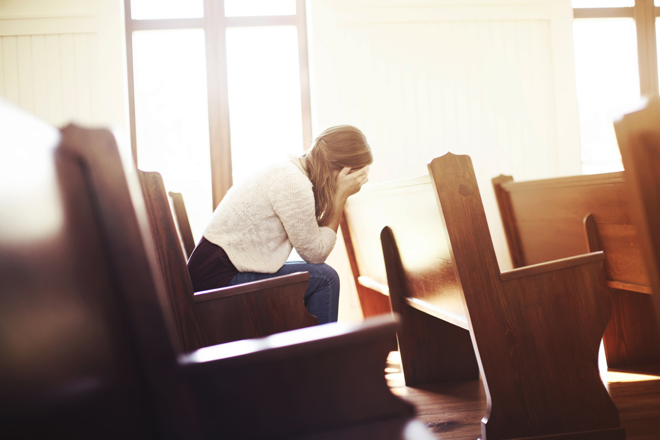
Why Should We Care?
The magnitude of mental illness in this country is staggering.
Nearly every person sitting in our congregations has been touched in some way by mental illness.
And yet individuals and families continue to suffer in silence or stop coming to worship because they are not receiving the support they so desperately need.
They become detached from their faith community and their spirituality, which can be an important source of healing, wholeness and hope in times of personal darkness.
Notes:
The magnitude of mental illness in this country is staggering. According to
the Surgeon General, one in every five Americans experiences a mental
disorder in any given year and half of all Americans have such disorders at
some time in their lives. These illnesses of the brain affect all of us,
regardless of age, gender, economic status or ethnicity. Nearly every person
sitting in our congregations has been touched in some way by mental
illness. And yet individuals and families continue to suffer in silence or stop
coming to worship because they are not receiving the support they so
desperately need. They become detached from their faith community and
their spirituality, which can be an important source of healing, wholeness and
hope in times of personal darkness.
Persons with a mental illness or concerned family members are more likely to
seek help from their faith leader than from mental health professionals. Yet
studies have shown that clergy are least effective in providing appropriate
support, care and referral information. Too often the seminary training for
clergy is inadequate. Clergy have their own fears. Many faith leaders are
hiding their own mental illness or that of a family member. Serious mental
illness has been called the modern day leprosy.

Slide 41
Why Should We Care?
“Mental illness affects all aspects of our life including our spiritual well being. It strikes at the very soul of our being making us feel cut off or separated from God’s love and acceptance. It is like a thief in the night. It steals a person’s sense of self worth, their hopes and dreams for the future and it feels like it will always be this way. Mental illness challenges our core beliefs and values, and we often feel unworthy of God’s love and acceptance. We feel alienated from God. We feel alone, helpless and hopeless in the dark despair of our illness.”
- Mental Illness & Families of Faith – How congregations can respond, Rev Susan Gregg-Schroeder (MentalHealthMinistries.net)

Slide 42
The unique Role of Faith Communities
Spiritual (Sacred) Imperative to Care for Those Who Suffer
Hospitality means primarily the creation of a free space where the stranger can enter and become a friend instead of an enemy. Hospitality is not to change people but to offer them space where change can take place. It is not to bring men and women over to our side, but to offer freedom not disturbed by dividing lines. . . . The paradox of hospitality is that it wants to create emptiness, not a fearful emptiness, but a friendly emptiness where strangers can enter and discover themselves as created free; free to sing their own songs, speak their own languages, dance their own dances; free also to leave and follow their own vocations. Hospitality is not a subtle invitation to adore the lifestyle of the host, but the gift of a chance for the guest to find his own.
- Henri Nouwen -

Slide 43
CARING CONGREGATION
CARING CONGREGATION
EDUCATION
COMMITMENT (COVENANT)
ADVOCACY
WELCOME
SUPPORT

Slide 44
Connecting Mind, Body and Spirit:
a Path to Mental Wellbeing
We attend to the spiritual component of every person, the place within one’s sacred core where a person grounds his or her entire self.
We believe each soul is unique but not isolated. Samaritan helps people strike the vital balance between their individual sense of purpose and their place in the universe.
Samaritan helps people connect with that which transcends. Be it faith, religion, nature, or a connection to a special relative or artist, we know that humans seek connection and inspiration.
Samaritan facilitates the learning of cognitive coping capabilities and other healthy patterns that raise clients’ mind, body, and spirit to a new level of well-being.

Slide 45
Questions
What else do you want to know?
rberbert@samaritanfoxvalley.com
https://samaritanfoxvalley.com
Main Office:
1205 Province Terrace, Menasha
Branch offices:
110 Church Ave, Oshkosh
709 W. Pine St, New London
510 Sullivan Ave, Kaukauna

